Slide 1
Recursion for Beginners:
A Beginner's Guide to Recursion
@AlSweigart al@inventwithpython.com
bit.ly/nbpython2018recursion

Slide 2
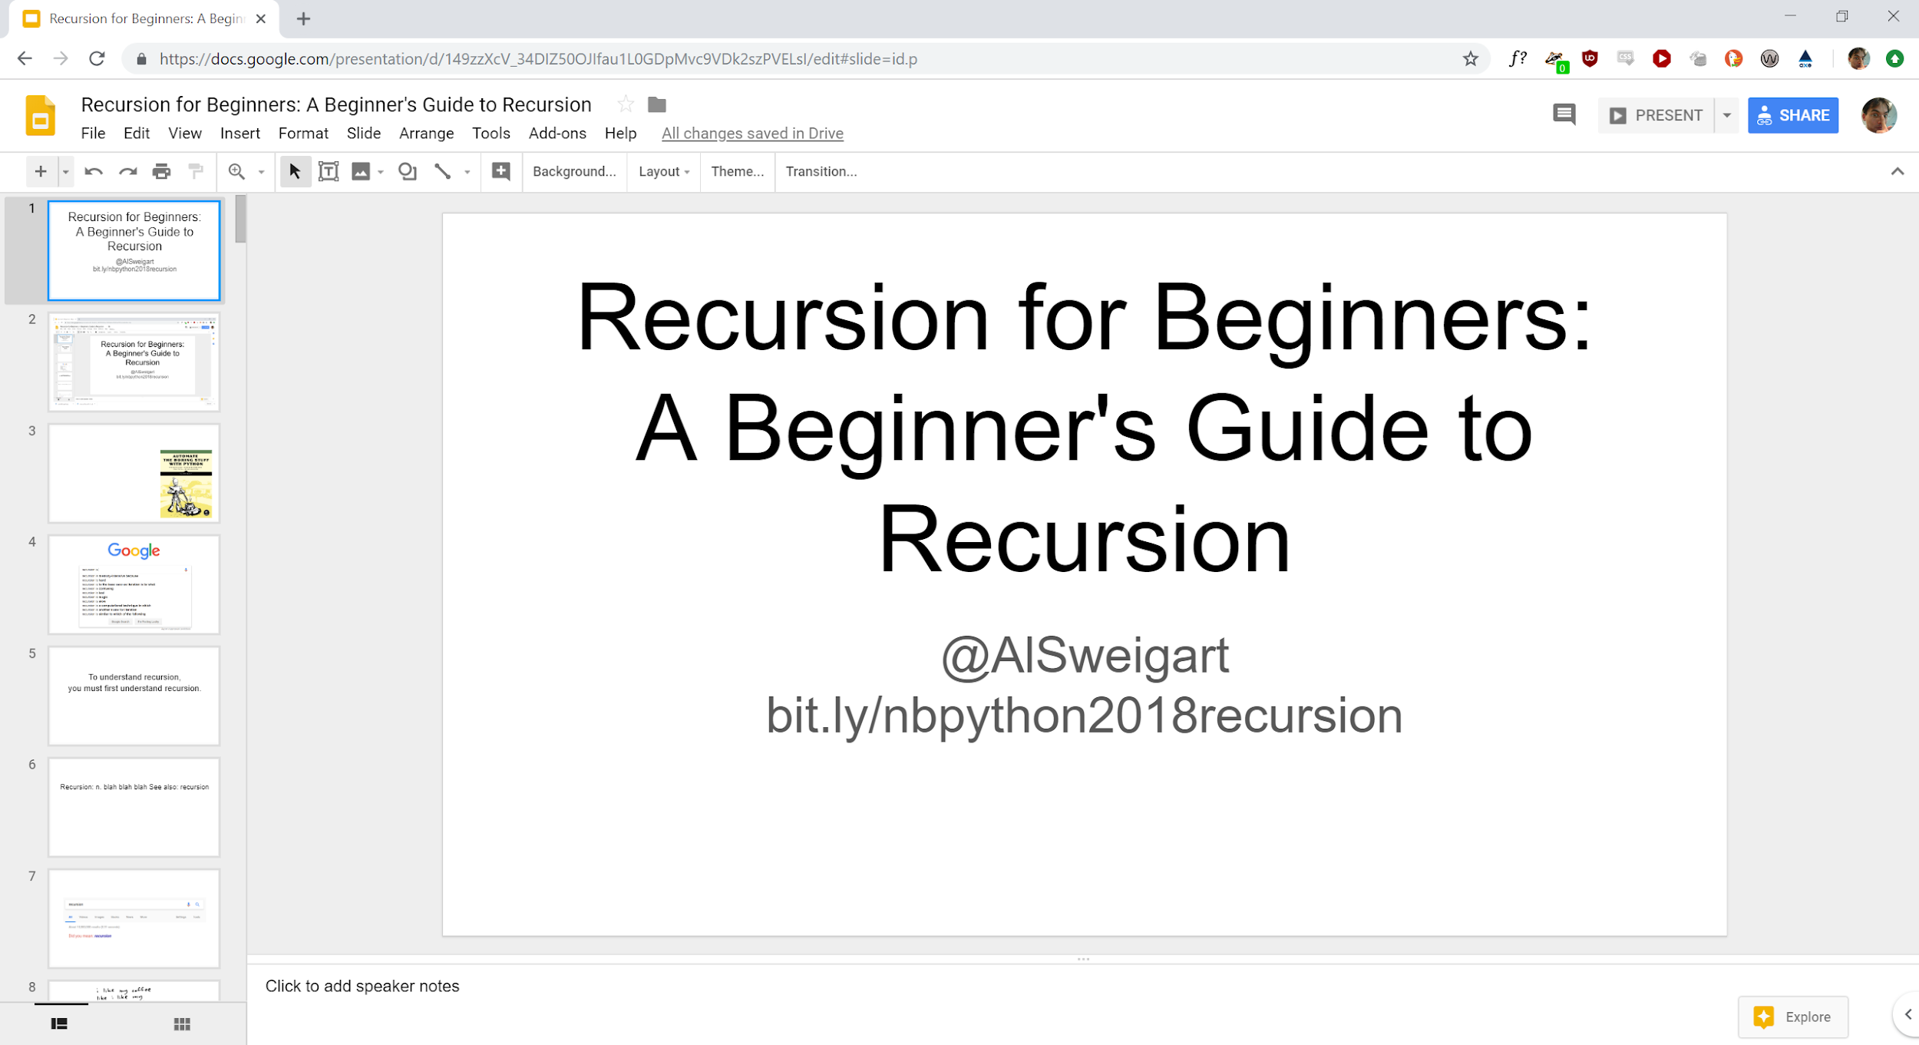

Slide 3
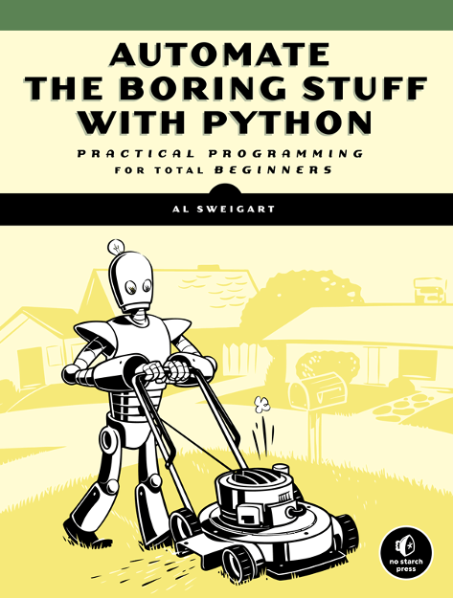

Slide 4


Slide 5
To understand recursion,
you must first understand recursion.

Slide 6
Recursion: n. blah blah blah See also: recursion

Slide 7
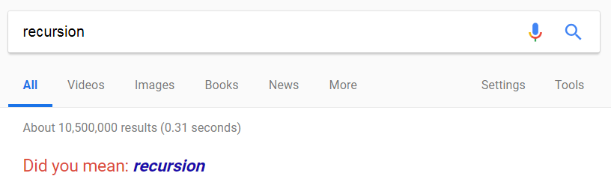

Slide 8
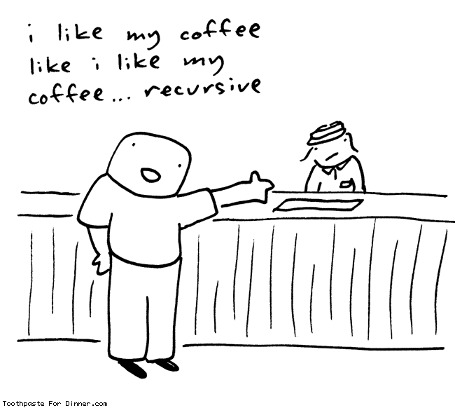

Slide 9
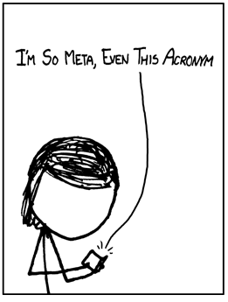

Slide 10
I.S.M.E.T.A.

Slide 11
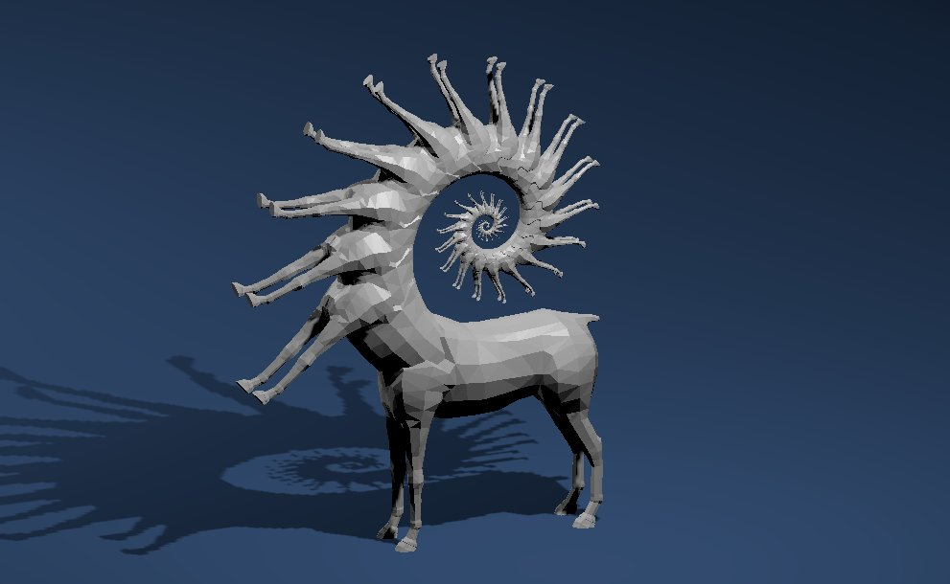

Slide 13
A recursive thing is something whose definition includes itself.

Slide 14
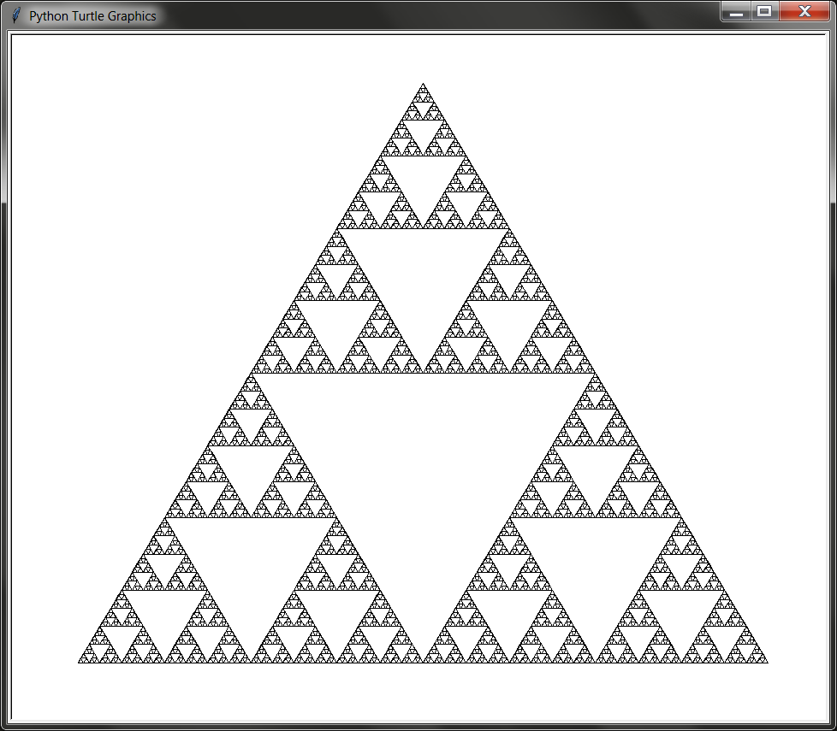
Sierpinski Triangle
https://github.com/asweigart/recursion_examples

Slide 16
In programming, recursion is when a function calls itself.

Slide 17
In programming, recursion is when a function calls itself.
def shortest():
shortest()

Slide 18
Traceback (most recent call last):
File "shortest.py", line 4, in <module>
shortest()
File "shortest.py", line 2, in shortest
shortest()
File "shortest.py", line 2, in shortest
shortest()
File "shortest.py", line 2, in shortest
shortest()
[Previous line repeated 996 more times]
RecursionError: maximum recursion depth exceeded

Slide 19
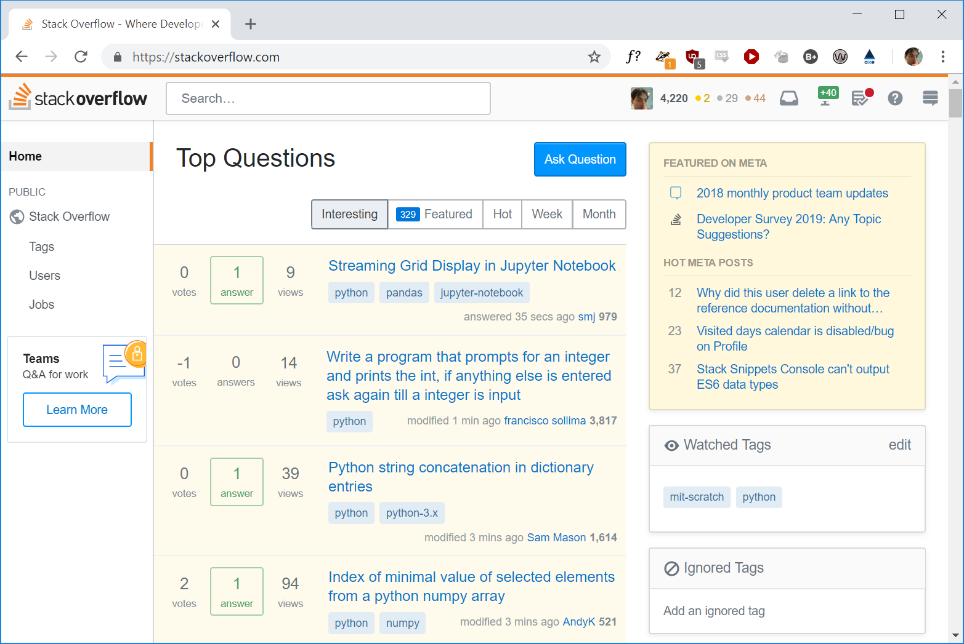
Traceback (most recent call last):
File "shortest.py", line 4, in <module>
shortest()
File "shortest.py", line 2, in shortest
shortest()
File "shortest.py", line 2, in shortest
shortest()
File "shortest.py", line 2, in shortest
shortest()
[Previous line repeated 996 more times]
RecursionError: maximum recursion depth exceeded

Slide 20
To understand recursion,
you must first understand recursion.

Slide 21
To understand recursion,
you must first understand recursion.
STACKS

Slide 23
A stack is a data structure that holds a sequence of data and only lets you interact with the topmost item.

Slide 24
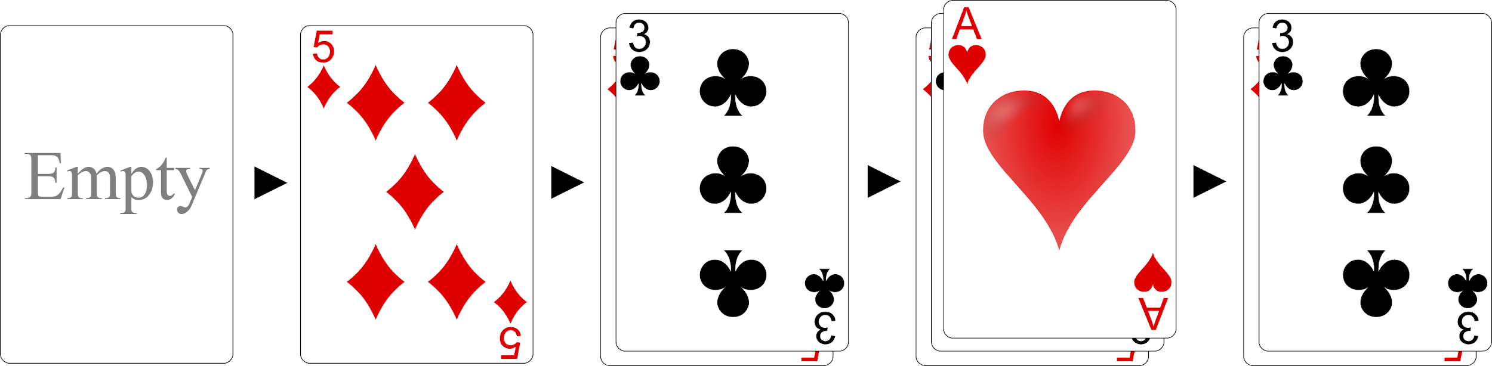
A stack is a data structure that holds a sequence of data and only lets you interact with the topmost item.
First-In, Last-Out (FILO)

Slide 25
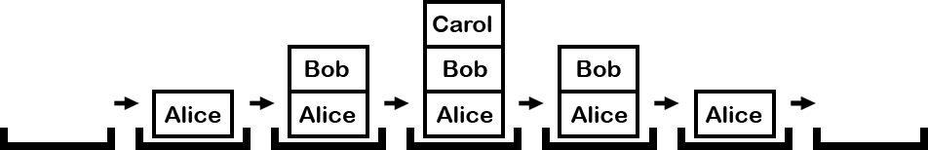
A stack is a data structure that holds a sequence of data and only lets you interact with the topmost item.

Slide 26
Adding to the top of the stack is called pushing.
Removing from the top of the stack is called popping.

Slide 27
Adding to the top of the stack is called pushing.
Removing from the top of the stack is called popping.
Python’s lists are a stack if you only use append() and pop().

Slide 28
>>> spam = []
>>> spam.append('Alice')
>>> spam.append('Bob')
>>> spam.append('Carol')
>>> spam.pop()
'Carol'
>>> spam
['Alice', 'Bob']

Slide 29
def a():
print('Start of a()')
b()
print('End of a()')
def b():
print('Start of b()')
c()
print('End of b()')
def c():
print('Start of c()')
print('End of c()')
a()

Slide 30
def a():
print('Start of a()')
b()
print('End of a()')
def b():
print('Start of b()')
c()
print('End of b()')
def c():
print('Start of c()')
print('End of c()')
a()
Start of a()
Start of b()
Start of c()
End of c()
End of b()
End of a()

Slide 31
def a():
print('Start of a()')
b()
print('End of a()')
def b():
print('Start of b()')
c()
print('End of b()')
def c():
print('Start of c()')
print('End of c()')
a()
Start of a()
Start of b()
Start of c()
End of c()
End of b()
End of a()
“GOTO Considered Harmful”

Slide 32
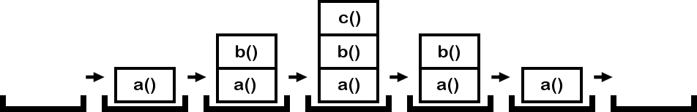
The “call stack” is a stack of “frame objects”.
(frame object == a function call)

Slide 33
Recursion is a lot easier to understand if you understand stacks and the call stack.

Slide 34
def a():
print('Start of a()')
b()
print('End of a()')
def b():
print('Start of b()')
c()
print('End of b()')
def c():
print('Start of c()')
print('End of c()')
a()
Start of a()
Start of b()
Start of c()
End of c()
End of b()
End of a()

Slide 35
def a():
print('Start of a()')
b()
print('End of a()')
def b():
print('Start of b()')
c()
print('End of b()')
def c():
print('Start of c()')
print('End of c()')
a()
Start of a()
Start of b()
Start of c()
End of c()
End of b()
End of a()
“Where’s the call stack?”

Slide 36
Extra Credit
Look up the inspect and traceback modules.
Doug Hellmann’s “Python Module of the Week” blog:
https://pymotw.com/3/inspect/
https://pymotw.com/3/traceback/

Slide 38
Recursion is overrated.

Slide 40
Factorial
5! = 5 × 4 × 3 × 2 × 1 = 120
2! = 2 × 1 = 2
4! = 4 × 3 × 2 × 1 = 24

Slide 41
Factorial
5! = 5 × 4 × 3 × 2 × 1 = 120
4! = 4 × 3 × 2 × 1 = 24

Slide 42
Factorial
5! = 5 × 4 × 3 × 2 × 1 = 120
4! = 4 × 3 × 2 × 1 = 24
5! = 5 × 4!

Slide 43
Factorial
5! = 5 × 4 × 3 × 2 × 1 = 120
4! = 4 × 3 × 2 × 1 = 24
5! = 5 × 4! = 5 × 24 = 120

Slide 44
Factorial
Number! = Number × (Number - 1)!
(Factorial has a recursive nature.)

Slide 45
Factorial
Number! = Number × (Number - 1)!
def factorial(number):
return number * factorial(number - 1)
print(factorial(5))

Slide 46
Factorial
Traceback (most recent call last):
File "factorial.py", line 4, in <module>
print(factorial(5))
File "factorial.py", line 2, in factorial
return number * factorial(number - 1)
File "factorial.py", line 2, in factorial
return number * factorial(number - 1)
File "factorial.py", line 2, in factorial
return number * factorial(number - 1)
[Previous line repeated 996 more times]
RecursionError: maximum recursion depth exceeded

Slide 47
Factorial
5! = 5 × 4 × 3 × 2 × 1 = 120

Slide 48
Factorial
5! = 5 × 4 × 3 × 2 × 1 = 120
5! = 5 × 4 × 3 × 2 × 1 × 0 × -1 × -2 × ...

Slide 49
Factorial
5! = 5 × 4 × 3 × 2 × 1 = 120
5! = 5 × 4 × 3 × 2 × 1 × 0 × -1 × -2 × ...
A stack overflow is when a recursive function gets out of control and doesn’t stop recursing.

Slide 50
Factorial
Traceback (most recent call last):
File "factorial.py", line 4, in <module>
print(factorial(5))
File "factorial.py", line 2, in factorial
return number * factorial(number - 1)
File "factorial.py", line 2, in factorial
return number * factorial(number - 1)
File "factorial.py", line 2, in factorial
return number * factorial(number - 1)
[Previous line repeated 996 more times]
RecursionError: maximum recursion depth exceeded

Slide 51
Factorial
def factorial(number):
return number * factorial(number - 1)
print(factorial(5))

Slide 52
Factorial (hint: 1! = 1)
def factorial(number):
return number * factorial(number - 1)
print(factorial(5))

Slide 53
Factorial (hint: 1! = 1)
def factorial(number):
if number == 1:
return 1
return number * factorial(number - 1)
print(factorial(5))

Slide 54
Factorial (hint: 1! = 1)
def factorial(number):
if number == 1:
return 1 # BASE CASE
# RECURSIVE CASE
return number * factorial(number - 1)
print(factorial(5))

Slide 55
Your recursive function must always have at least one base case and one recursive case.

Slide 56
Factorial (hint: 1! = 1)
def factorial(number):
if number == 1:
return 1 # BASE CASE
# RECURSIVE CASE
return number * factorial(number - 1)
print(factorial(5))

Slide 57
Factorial (hint: 1! = 1)
“Where does the 5 × 4 ×
3 × 2 × 1 happen?”
def factorial(number):
if number == 1:
return 1 # BASE CASE
# RECURSIVE CASE
return number * factorial(number - 1)
print(factorial(5))

Slide 58
The “call stack” is a stack of “frame objects”.
(frame object == a function call)

Slide 59
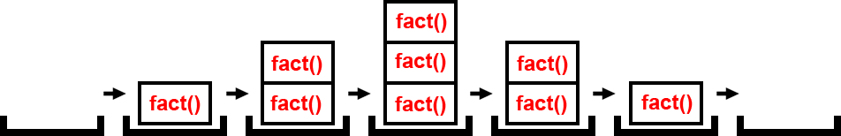
The “call stack” is a stack of “frame objects”.
(frame object == a function call)

Slide 60
The “call stack” is a stack of “frame objects”.
(frame object == a function call)

Slide 61
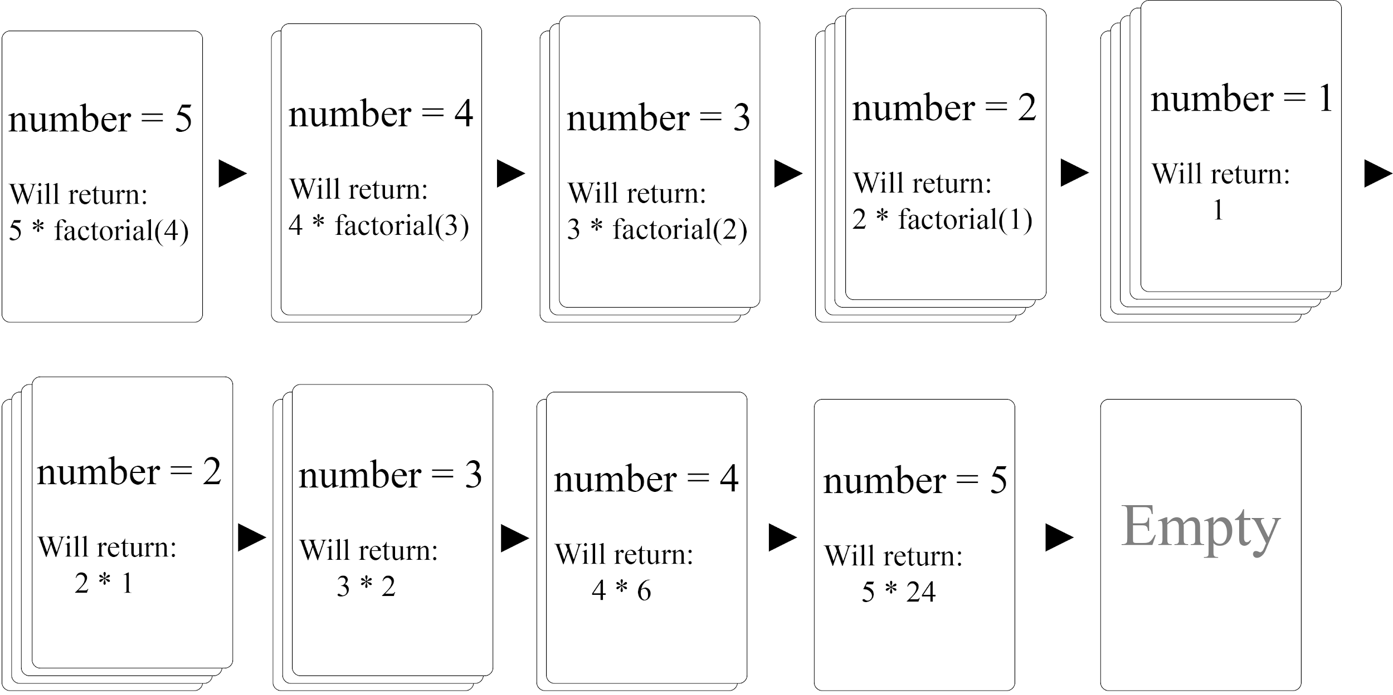
Frame objects are where local variables are stored.

Slide 62
def factorial(number):
if number == 1:
return 1 # BASE CASE
# RECURSIVE CASE
return number * factorial(number - 1)

Slide 63
# Hard-coded pseudo-recursive algorithm
def factorial5():
return 5 * factorial4()
def factorial4():
return 4 * factorial3()
def factorial3():
return 3 * factorial2()
def factorial2():
return 2 * factorial1()
def factorial1():
return 1
print(factorial5())

Slide 64
# Iterative factorial algorithm
def factorial(number):
total = 1
for i in range(1, number):
total *= i
return total
print(factorial(5))

Slide 66
# Using iteration to emulate recursion.
callStack = [] # The explicit call stack, which holds "frame objects".
callStack.append({'instrPtr': 'start', 'number': 5}) # "Call" the "factorial() function"
returnValue = None
while len(callStack) > 0:
# The body of the "factorial() function":
number = callStack[-1]['number'] # Set number "parameter".
instrPtr = callStack[-1]['instrPtr']
if instrPtr == 'start':
if number == 1:
# BASE CASE
returnValue = 1
callStack.pop() # "Return" from "function call".
continue
else:
# RECURSIVE CASE
callStack[-1]['instrPtr'] = 'after recursive call'
# "Call" the "factorial() function":
callStack.append({'instrPtr': 'start', 'number': number - 1})
continue
elif instrPtr == 'after recursive call':
returnValue = number * returnValue
callStack.pop() # "Return from function call".
continue
print(returnValue)

Slide 68
When should we use recursion?

Slide 69
When should we use recursion?
Never.

Slide 70
When should we use recursion?

Slide 71
When should we use recursion?
When the problem has a tree-like structure.

Slide 72
When should we use recursion?
When the problem has a tree-like structure.
When the problem requires backtracking.

Slide 73
When should we use recursion?
When the problem has a tree-like structure.
When the problem requires backtracking.
(Both of these are required.)

Slide 74
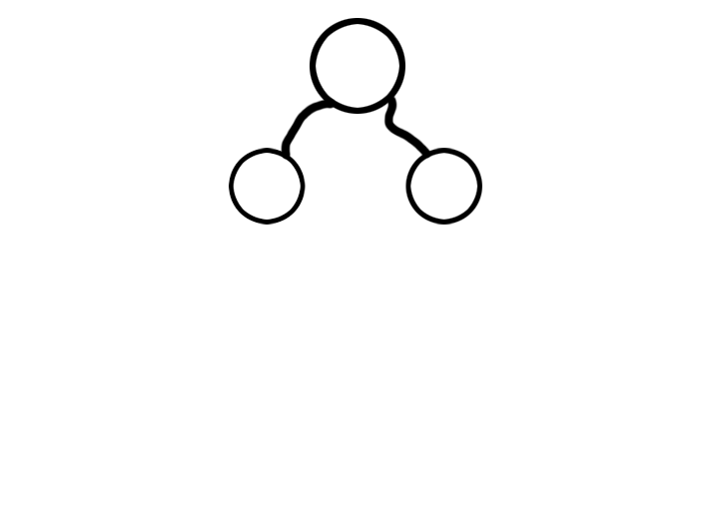

Slide 75
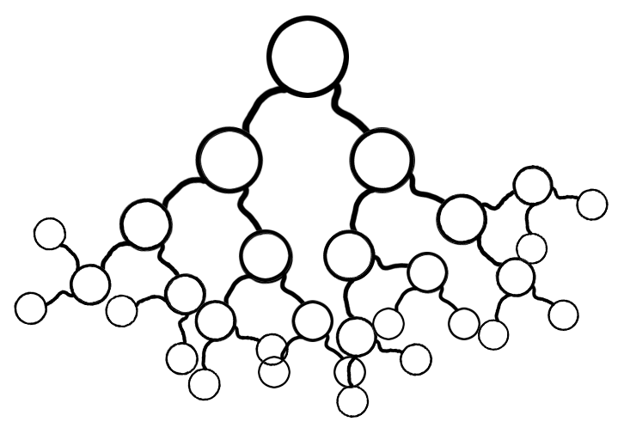

Slide 76
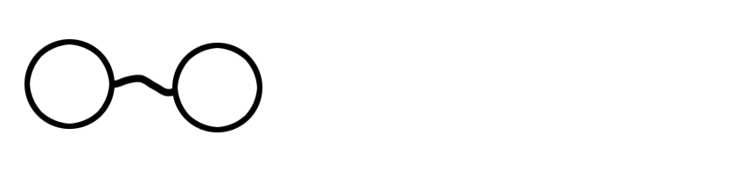

Slide 77
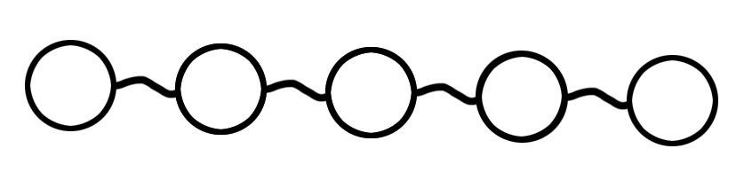

Slide 78
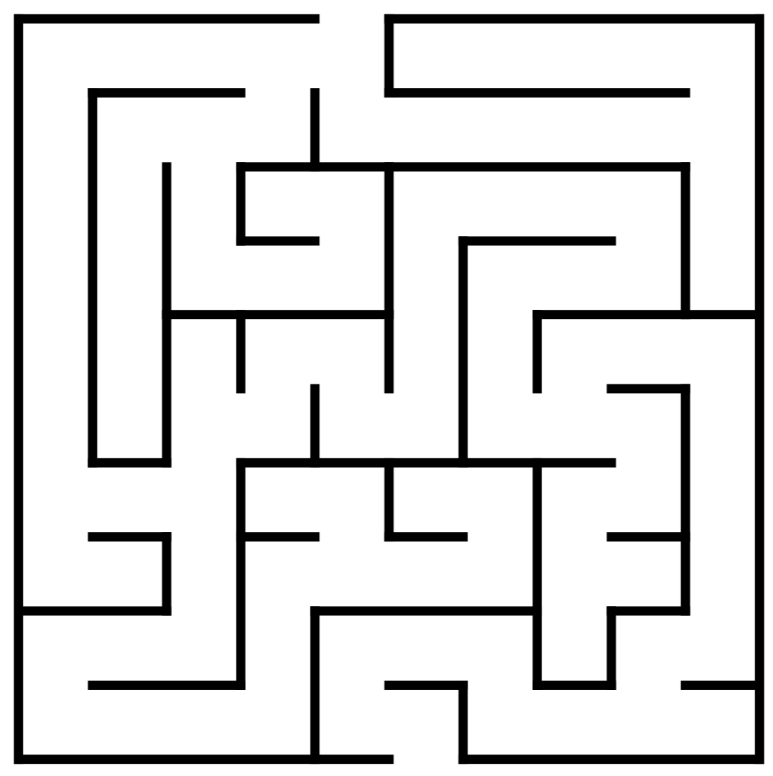

Slide 79
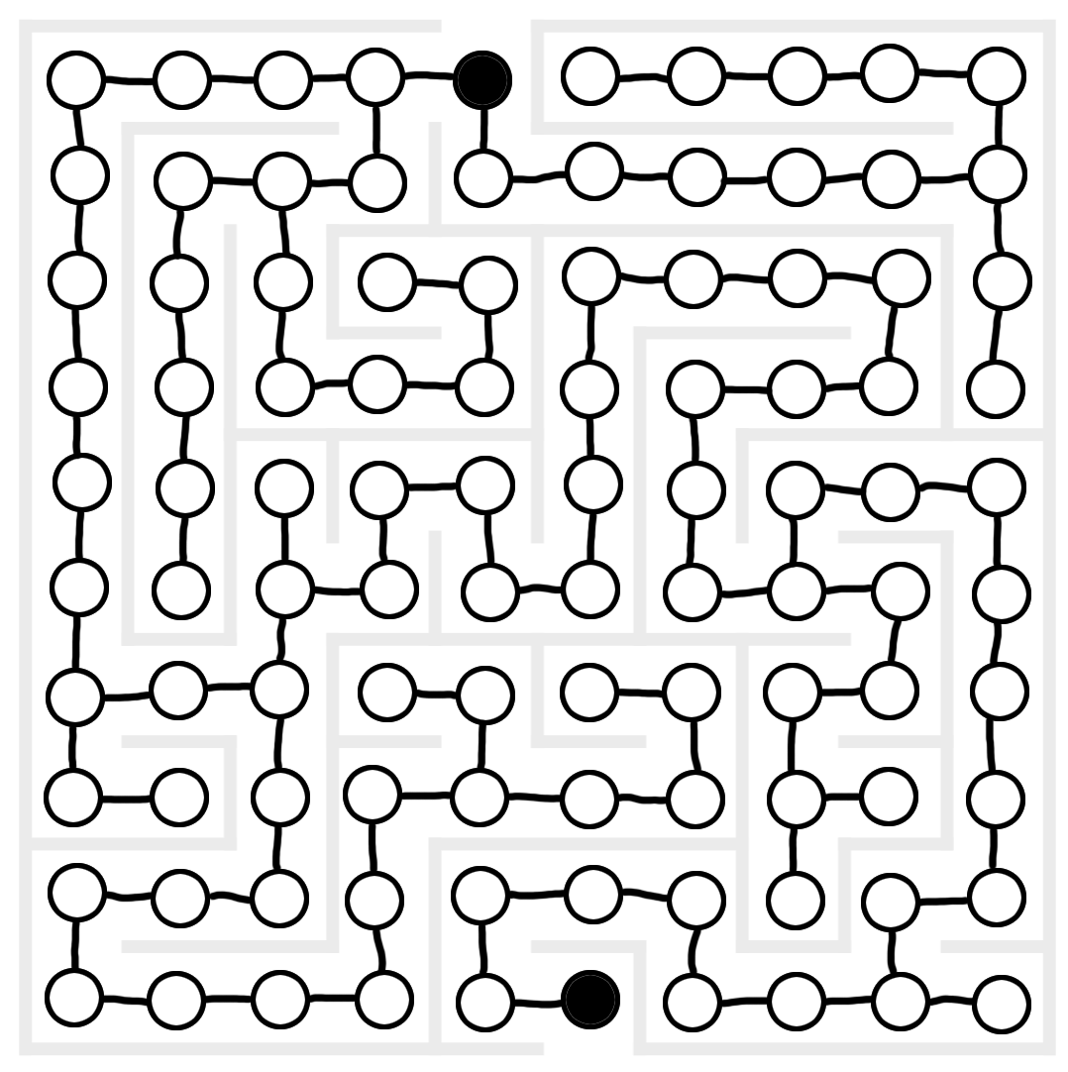

Slide 80
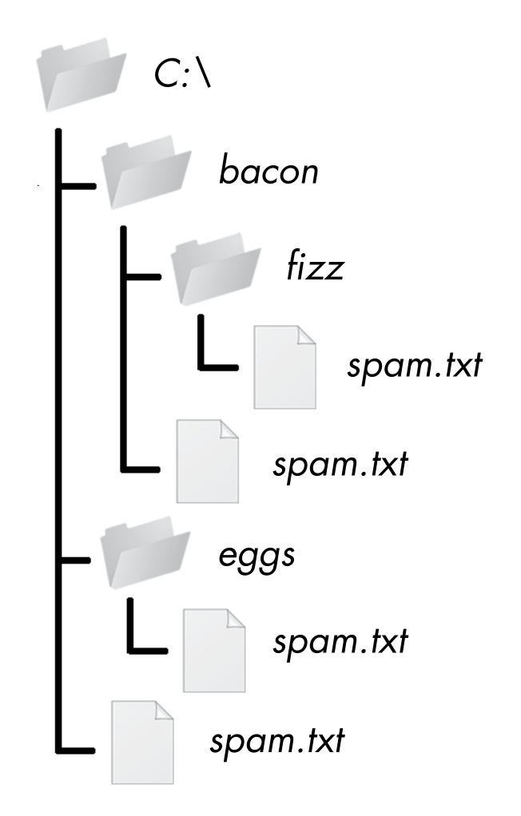

Slide 81
So when should we use recursion?
When the problem has a tree-like structure.
When the problem requires backtracking.
Otherwise, you don’t have to use recursion.

Slide 82
factorial(1001)

Slide 83
factorial(1001)
Traceback (most recent call last):
File "factorialByRecursion.py", line 8, in <module>
print(factorial(1001))
File "factorialByRecursion.py", line 7, in factorial
return number * factorial(number - 1)
File "factorialByRecursion.py", line 7, in factorial
return number * factorial(number - 1)
File "factorialByRecursion.py", line 7, in factorial
return number * factorial(number - 1)
[Previous line repeated 995 more times]
File "factorialByRecursion.py", line 2, in factorial
if number == 1:
RecursionError: maximum recursion depth exceeded in comparison

Slide 84
Tail Call Optimization/Elimination
What if the problem is big enough that it really does require more than 1000 function calls?
factorial(1001)

Slide 85
Tail Call Optimization/Elimination
In code, tail call optimization/elimination is when the recursive function call is the last thing in the function before it returns:
def recursiveFunc(params):
# blah blah blah
return recursiveFunc(params) # RECURSIVE CASE
(The recursive function call comes at the “tail” of the function.)

Slide 86
Tail Call Optimization/Elimination
return recursiveFunc(params) # RECURSIVE CASE
You won’t need to hold on to local variables, because there’s no code after the recursive function call that will need them.

Slide 87
Tail Call Optimization/Elimination
return recursiveFunc(params) # RECURSIVE CASE
You won’t need to hold on to local variables, because there’s no code after the recursive function call that will need them.
There’s no need to keep the frame object on the call stack.

Slide 88
Tail Call Optimization/Elimination
return recursiveFunc(params) # RECURSIVE CASE
You won’t need to hold on to local variables, because there’s no code after the recursive function call that will need them.
There’s no need to keep the frame object on the call stack.
You can go beyond 1000 function calls because the call stack isn’t growing.
TCO prevents stack overflows.

Slide 89
Tail Call Optimization/Elimination
Tail call optimization is overrated.

Slide 90
Normal Recursive Factorial Can’t be TC Optimized
def factorial(number):
if number == 1:
# BASE CASE
return 1
else:
# RECURSIVE CASE
return number * factorial(number - 1)
print(factorial(5))

Slide 91
Factorial with Tail Call Optimization
def factorial(number, accumulator=1):
if number == 0:
# BASE CASE
return accumulator
else:
# RECURSIVE CASE
return factorial(number - 1, number * accumulator)
print(factorial(5))

Slide 92
Tail call optimization is a compiler trick...

Slide 93
Tail call optimization is a compiler trick…
...that CPython doesn’t implement...

Slide 94
Tail call optimization is a compiler trick…
...that CPython doesn’t implement...
...and never will.

Slide 95
“If you want a short answer, it's simply unpythonic.”
-Guido
http://neopythonic.blogspot.com.au/2009/04/tail-recursion-elimination.html
http://neopythonic.blogspot.com.au/2009/04/final-words-on-tail-calls.html

Slide 97
Fibonacci Sequence
1, 1, 2, 3, 5, 8, 13, 21, 34 ...

Slide 98
Fibonacci Sequence
1, 1, 2, 3, 5, 8, 13, 21, 34 …
fib(1) = 1, fib(2) = 1, fib(3) = 2, fib(4) = 3

Slide 99
Fibonacci Sequence
1, 1, 2, 3, 5, 8, 13, 21, 34 …
fib(1) = 1, fib(2) = 1, fib(3) = 2, fib(4) = 3
fib(N) = fib(N - 1) + fib(N - 2)
fib(1) and fib(2) = 1

Slide 100
Recursive Fibonacci
def fib(nthNumber):
if nthNumber == 1 or nthNumber == 2:
# BASE CASE
return 1
else:
# RECURSIVE CASE
return fib(nthNumber - 2) + fib(nthNumber - 1)

Slide 101
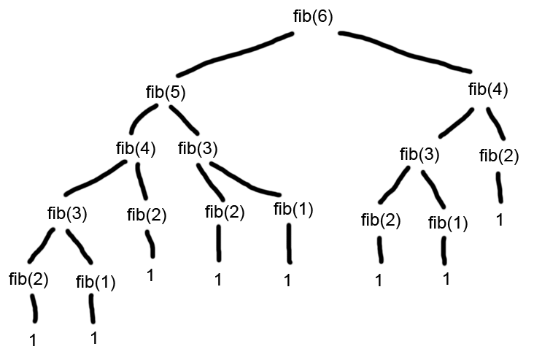

Slide 102
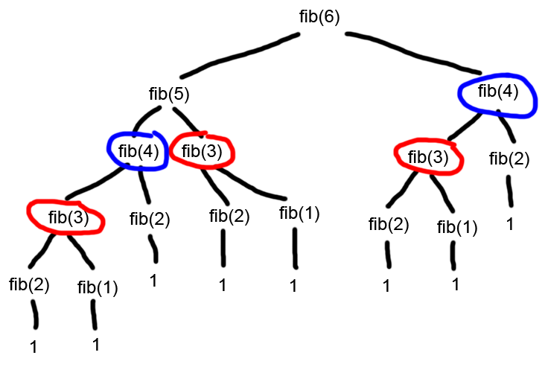

Slide 103
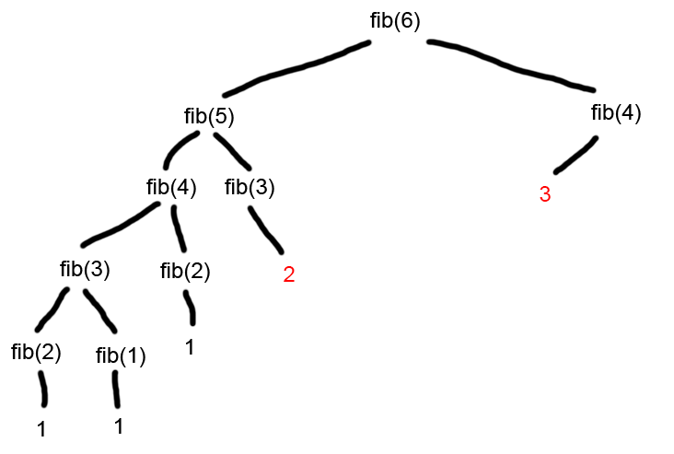

Slide 104
Recursive Fibonacci with Memoization
FIB_CACHE = {}
def fib(nthNumber):
if nthNumber in FIB_CACHE:
return FIB_CACHE[nthNumber]
if nthNumber == 1 or nthNumber == 2:
# BASE CASE
return 1
else:
# RECURSIVE CASE
FIB_CACHE[nthNumber] = fib(nthNumber - 2) + fib(nthNumber - 1)
return FIB_CACHE[nthNumber]

Slide 105
Recursive Fibonacci with Memoization
import functools
@functools.lru_cache()
def fib(nthNumber):
if nthNumber == 1 or nthNumber == 2:
# BASE CASE
return 1
else:
# RECURSIVE CASE
return fib(nthNumber - 2) + fib(nthNumber - 1)

Slide 107
To understand recursion, you must first understand stacks.

Slide 108
To understand recursion, you must first understand stacks.
Recursion is hard to learn because the call stack is invisible.

Slide 109
To understand recursion, you must first understand stacks.
Recursion is hard to learn because the call stack is invisible.
You always need at least one base case and one recursive case.

Slide 110
To understand recursion, you must first understand stacks.
Recursion is hard to learn because the call stack is invisible.
You always need at least one base case and one recursive case.
Function calls push a frame object onto the stack, returning pops them off.

Slide 111
To understand recursion, you must first understand stacks.
Recursion is hard to learn because the call stack is invisible.
You always need at least one base case and one recursive case.
Function calls push a frame object onto the stack, returning pops them off.
Stack overflows happen when you make too many function calls without returning.

Slide 112
To understand recursion, you must first understand stacks.
Recursion is hard to learn because the call stack is invisible.
You always need at least one base case and one recursive case.
Function calls push a frame object onto the stack, returning pops them off.
Stack overflows happen when you make too many function calls without returning.
Anything you can do with recursion you can do with a loop and a stack.

Slide 113
To understand recursion, you must first understand stacks.
Recursion is hard to learn because the call stack is invisible.
You always need at least one base case and one recursive case.
Function calls push a frame object onto the stack, returning pops them off.
Stack overflows happen when you make too many function calls without returning.
Anything you can do with recursion you can do with a loop and a stack.
Use recursion only when the problem has a tree-like structure and requires backtracking.

Slide 114
To understand recursion, you must first understand stacks.
Recursion is hard to learn because the call stack is invisible.
You always need at least one base case and one recursive case.
Function calls push a frame object onto the stack, returning pops them off.
Stack overflows happen when you make too many function calls without returning.
Anything you can do with recursion you can do with a loop and a stack.
Use recursion only when the problem has a tree-like structure and requires backtracking.
Tail call elimination prevents stack overflows by preventing the call stack from growing. CPython doesn’t implement TCO.

Slide 115
To understand recursion, you must first understand stacks.
Recursion is hard to learn because the call stack is invisible.
You always need at least one base case and one recursive case.
Function calls push a frame object onto the stack, returning pops them off.
Stack overflows happen when you make too many function calls without returning.
Anything you can do with recursion you can do with a loop and a stack.
Use recursion only when the problem has a tree-like structure and requires backtracking.
Tail call elimination prevents stack overflows by preventing the call stack from growing. CPython doesn’t implement TCO.
Memoization can speed up recursive algorithms by caching return values.

Slide 116
@AlSweigart
al@inventwithpython.com
bit.ly/nbpython2018recursion

